Slide 1
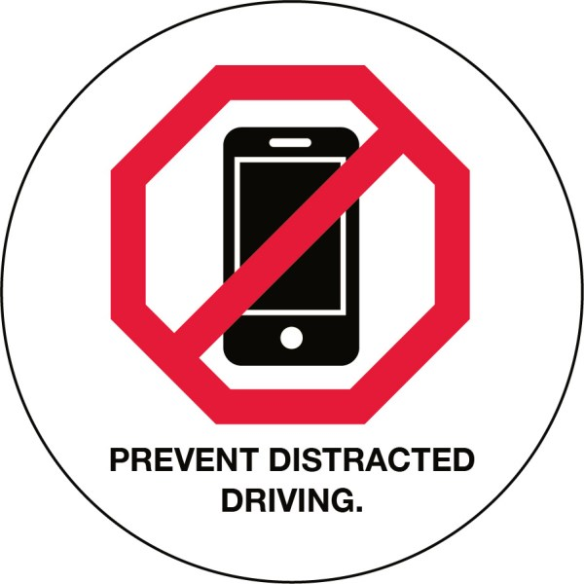
DRIVEN TO DISTRACTION

Slide 2
ASSIGNMENT
With your partner, you will select an image/graph/chart to EXTEND the article’s scope. The visual should be related to the piece but not a direct representation of material already addressed.
Paste the image into an email to me and your partner.
Create a question (type it into the email) that asks the reader to interpret the visual; consider the purpose of your visual choice, and/or how it connects to the article, reflects purpose, hints at tone, etc. Include four possible answers.
Also include an answer key that explains the correct answer.

Slide 3
SAMPLE VISUAL and QUESTION (you also need an answer key/explanation of the correct answer
The article notes that a former head of the National Highway Traffic Safety Administration referred to traffic fatalities as “a crisis that needs to be addressed now.” In which states should the NHTSA prioritize their response/action plan?
CA, NV, and AZ
PA, TX, and MT
NY, CT, and RI
GA, FL, and NC

Slide 4
SAMPLE VISUAL and QUESTION (you also need an answer key and explanation of the correct answer)
The hook mentions two different car accidents. In one, the distracted driver survived; in the other, she didn’t. Think about those scenarios and the picture; what message are the image and hooks clearly trying to convey?
The best way to stay safe in the car is to buy a vehicle with stellar safety ratings.
Car companies should do more to explore driverless cars.
Even safe cars don’t always protect people from distracted driving/distracted drivers.
Crash tests need to be revised in developing more stringent car safety codes.

